Slide 1
LSI systems, Fourier transforms, Sampling theory
Math Tools Tutorial Oct 17, 2019
Lyndon Duong

Slide 2

Learning objectives:
Linear shift-invariant systems
Convolution framework
Sinusoids as inputs to LSI systems
Complex numbers
Fourier series and transforms
Convolution theorem
Sampling theory
Aliasing
Nyquist theorem
LSI

Slide 3
Exercise 1: Testing LSI systems
labsystems.p is a function given to you that has 2 systems in it.
To pass a signal through system1, type:
output = labsystems(signal, 1) % 1 means sys 1, replace w 2 for sys 2
1) Is System 1 linear?
2) Is it shift in variant?
3) How does it handle boundaries?

Slide 4
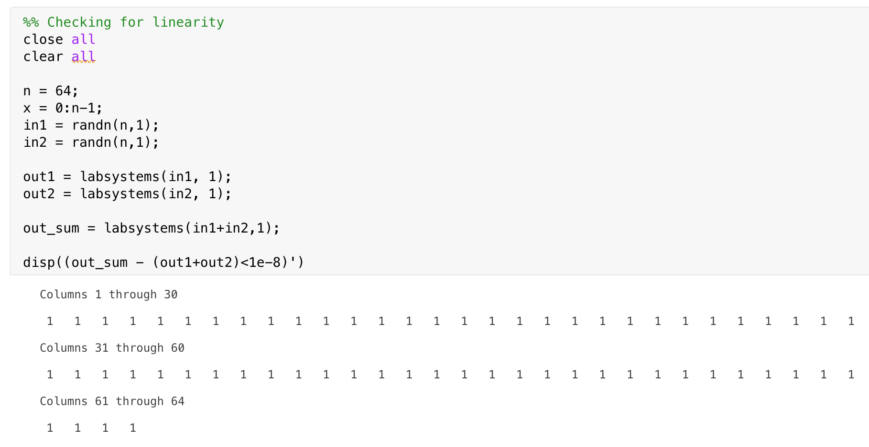
Exercise 1.1 : Testing LSI systems
How do I check for linearity in a system?
It is linear!

Slide 5
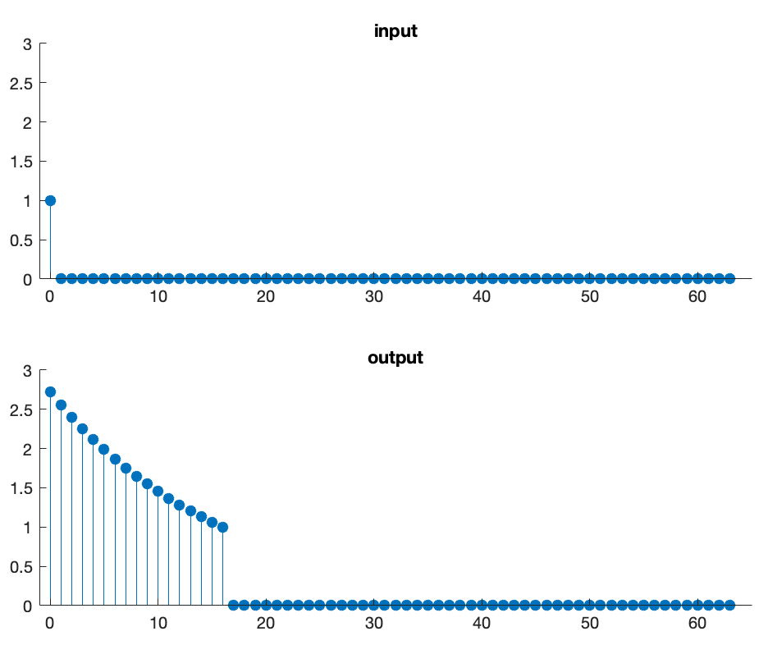
Exercise 1.2: Testing LSI systems
Is it shift-invariant?
How do I test for shift-invariance?

Slide 6
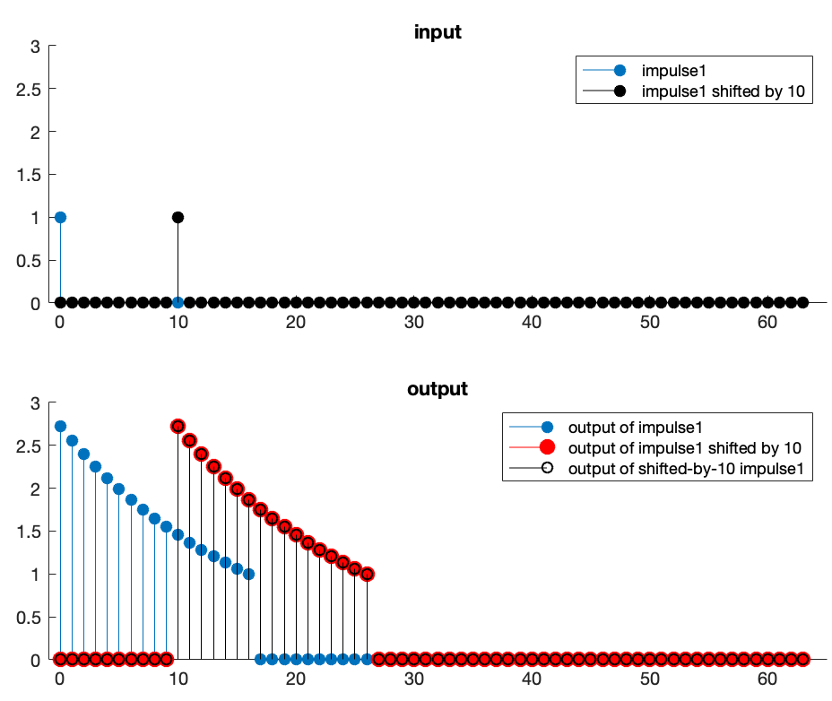
Exercise 1.3: Testing LSI systems
How do you test for shift-invariance?
impulse = zeros(64,1);
impulse(1) = 1;
impulse_10 = circshift(impulse, 10)
output = labsystems(impulse,1);
output_10 = labsystems(impulse_10,1);
disp(output_10 – circshift(output,10) < 1e-8);
It is shift-invariant!
You want to test if the shifted input’s output equals the original input’s output, shifted.
(Which is a super confusing statement but ponder on it a little bit and it will make sense)

Slide 7
What operation is a LSI system effectively doing?
Hint:
Each output is a shifted copy of the original impulse response.
Answer: Convolution!

Slide 8
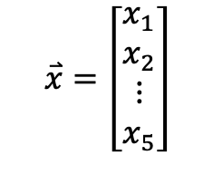
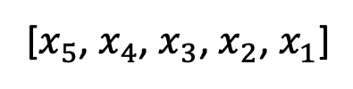

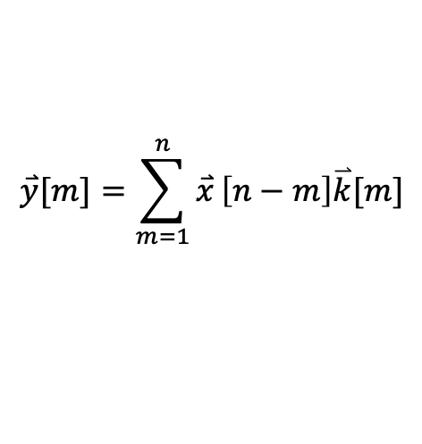
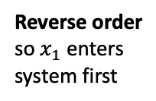
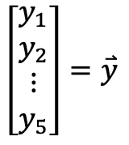
How I think of LSI systems:
Input: vector of size n=9
Output: vector of size n=9
$$\overset{⃑}{x}=\left[\begin{matrix}x_{1} \\ x_{2} \\ ⋮ \\ x_{5}\end{matrix}\right]$$
$$\left[\begin{matrix}y_{1} \\ y_{2} \\ ⋮ \\ y_{5}\end{matrix}\right]=\overset{⃑}{y}$$
$$\overset{⃑}{y}[m]=\sum_{m=1}^{n}{\overset{⃑}{x}}\left[n−m\right]\overset{⃑}{k}[m]$$
Reverse order so $x_{1}$ enters system first
Reverse the order back
Black box LSI system
[$x_{5}$, $x_{4}$, $x_{3}$, $x_{2}$, $x_{1}$]
[$y_{5}$, $y_{4}$, $y_{3}$, $y_{2}$, $y_{1}$]
Gif source: https://www.youtube.com/watch?v=HQp6n_oJpLI

Slide 9



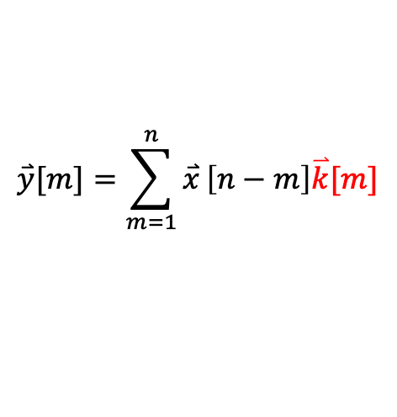
Looking inside the black box…
$$\overset{⃑}{y}[m]=\sum_{m=1}^{n}{\overset{⃑}{x}}\left[n−m\right]\overset{⃑}{k}[m]$$
X-ray of LSI system
DOT PRODUCT overlapping components
[$k_{1}$, $k_{2}$, $k_{3}$]
[$x_{5}$, $x_{4}$, $x_{3}$, $x_{2}$, $x_{1}$]
[$y_{5}$, $y_{4}$, $y_{3}$, $y_{2}$, $y_{1}$]
Gif source: https://www.youtube.com/watch?v=HQp6n_oJpLI

Slide 10



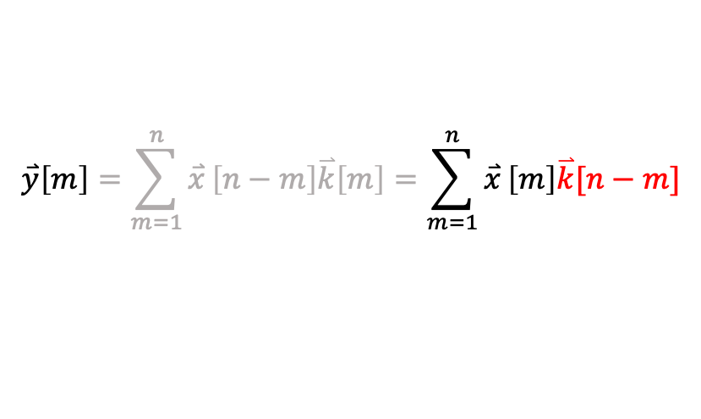

Having our input $\overset{⃑}{x}$ be oriented normally
$$\overset{⃑}{y}\left[m\right]=\sum_{m=1}^{n}{\overset{⃑}{x}}\left[n−m\right]\overset{⃑}{k}\left[m\right]=\sum_{m=1}^{n}{\overset{⃑}{x}}\left[m\right]\overset{⃑}{k}[n−m]$$
Instead of flipping the input, we’ve now flipped the systems, i.e. ‘kernel’.
X-ray of LSI system
DOT PRODUCT overlapping components
[$k_{3}$, $k_{2}$, $k_{1}$]
[$y_{1}$, $y_{2}$, $y_{3}$, $y_{4}$, $y_{5}$]
[$x_{1}$, $x_{2}$, $x_{3}$, $x_{4}$, $x_{5}$]
Gif source: https://www.youtube.com/watch?v=HQp6n_oJpLI

Slide 11










But wait…
Despite the dimensions of input and output being the same (n=5), we did more than n dot products (7 to be exact)
[$k_{3}$, $k_{2}$, $k_{1}$]
1.
[$x_{1}$, $x_{2}$, $x_{3}$, $x_{4}$, $x_{5}$]
What do we do with the overhangs at step 1,2,6,7?
How can we compute a dot-product if there are gaps?
2.
[$k_{3}$, $k_{2}$, $k_{1}$]
[$x_{1}$, $x_{2}$, $x_{3}$, $x_{4}$, $x_{5}$]
3.
[$k_{3}$, $k_{2}$, $k_{1}$]
[$x_{1}$, $x_{2}$, $x_{3}$, $x_{4}$, $x_{5}$]
4.
[$k_{3}$, $k_{2}$, $k_{1}$]
[$x_{1}$, $x_{2}$, $x_{3}$, $x_{4}$, $x_{5}$]
5.
[$k_{3}$, $k_{2}$, $k_{1}$]
[$x_{1}$, $x_{2}$, $x_{3}$, $x_{4}$, $x_{5}$]
6.
[$k_{3}$, $k_{2}$, $k_{1}$]
[$x_{1}$, $x_{2}$, $x_{3}$, $x_{4}$, $x_{5}$]
7.
[$k_{3}$, $k_{2}$, $k_{1}$]
[$x_{1}$, $x_{2}$, $x_{3}$, $x_{4}$, $x_{5}$]

Slide 12
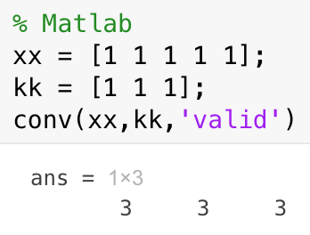
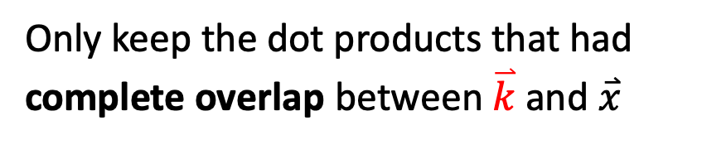
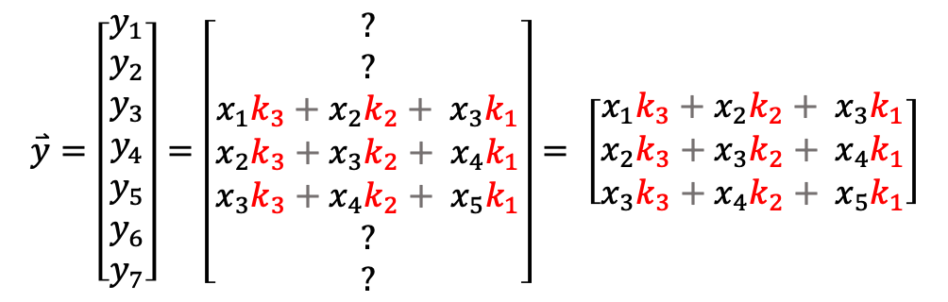
Solution 1: Ignore the dot products that had gaps
Only keep the dot products that had complete overlap between $\overset{⃑}{k}$ and $\overset{⃑}{x}$
[$k_{3}$, $k_{2}$, $k_{1}$]
1.
[$x_{1}$, $x_{2}$, $x_{3}$, $x_{4}$, $x_{5}$]
2.
[$k_{3}$, $k_{2}$, $k_{1}$]
[$x_{1}$, $x_{2}$, $x_{3}$, $x_{4}$, $x_{5}$]
$$\overset{⃑}{y}=\left[\begin{matrix}y_{1} \\ y_{2} \\ y_{3} \\ y_{4} \\ y_{5} \\ y_{6} \\ y_{7}\end{matrix}\right]=\left[\begin{matrix}? \\ ? \\ x_{1}k_{3}+x_{2}k_{2}+ x_{3}k_{1} \\ x_{2}k_{3}+x_{3}k_{2}+ x_{4}k_{1} \\ x_{3}k_{3}+x_{4}k_{2}+ x_{5}k_{1} \\ ? \\ ?\end{matrix}\right]= \left[\begin{matrix}x_{1}k_{3}+x_{2}k_{2}+ x_{3}k_{1} \\ x_{2}k_{3}+x_{3}k_{2}+ x_{4}k_{1} \\ x_{3}k_{3}+x_{4}k_{2}+ x_{5}k_{1}\end{matrix}\right]$$
3.
[$k_{3}$, $k_{2}$, $k_{1}$]
[$x_{1}$, $x_{2}$, $x_{3}$, $x_{4}$, $x_{5}$]
4.
[$k_{3}$, $k_{2}$, $k_{1}$]
[$x_{1}$, $x_{2}$, $x_{3}$, $x_{4}$, $x_{5}$]
5.
[$k_{3}$, $k_{2}$, $k_{1}$]
[$x_{1}$, $x_{2}$, $x_{3}$, $x_{4}$, $x_{5}$]
6.
[$k_{3}$, $k_{2}$, $k_{1}$]
[$x_{1}$, $x_{2}$, $x_{3}$, $x_{4}$, $x_{5}$]
7.
[$k_{3}$, $k_{2}$, $k_{1}$]
[$x_{1}$, $x_{2}$, $x_{3}$, $x_{4}$, $x_{5}$]

Slide 13
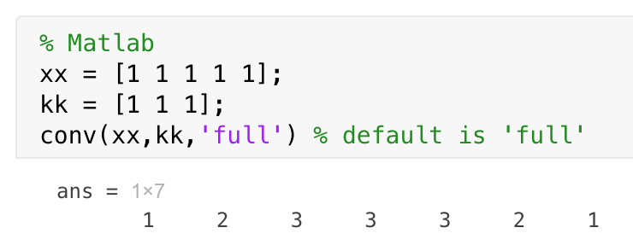
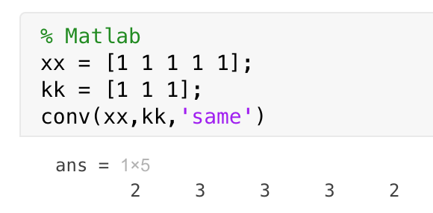










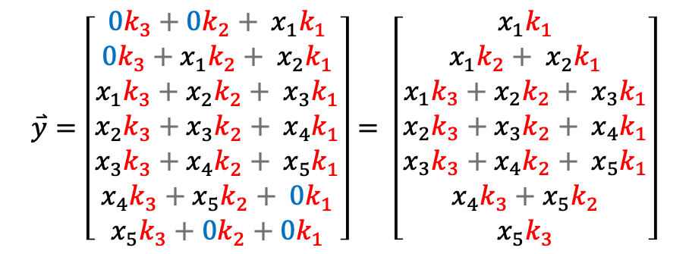
Solution 2: Zero-padding
${[k}_{3}$, $k_{2}$, $k_{1}]$
1.
[0, 0, $x_{1}$, $x_{2}$, $x_{3}$, $x_{4}$, $x_{5}$, 0, 0]
$$\overset{⃑}{y}=\left[\begin{matrix}{0k}_{3}+{0k}_{2}+ x_{1}k_{1} \\ {0k}_{3}+x_{1}k_{2}+ x_{2}k_{1} \\ x_{1}k_{3}+x_{2}k_{2}+ x_{3}k_{1} \\ x_{2}k_{3}+x_{3}k_{2}+ x_{4}k_{1} \\ x_{3}k_{3}+x_{4}k_{2}+ x_{5}k_{1} \\ x_{4}k_{3}+x_{5}k_{2}+ {0k}_{1} \\ {x_{5}k}_{3}+{0k}_{2}+0k_{1}\end{matrix}\right]= \left[\begin{matrix}x_{1}k_{1} \\ x_{1}k_{2}+ x_{2}k_{1} \\ x_{1}k_{3}+x_{2}k_{2}+ x_{3}k_{1} \\ x_{2}k_{3}+x_{3}k_{2}+ x_{4}k_{1} \\ x_{3}k_{3}+x_{4}k_{2}+ x_{5}k_{1} \\ x_{4}k_{3}+x_{5}k_{2} \\ x_{5}k_{3}\end{matrix}\right]$$
2.
${[k}_{3}$, $k_{2}$, $k_{1}]$
[0, 0, $x_{1}$, ${ x}_{2}$, $x_{3}$, $x_{4}$, $x_{5}$, 0, 0]
3.
${[k}_{3}$, $k_{2}$, $k_{1}]$
[0, 0, $x_{1}$, $x_{2}$, $x_{3}$, $x_{4}$, $x_{5}$, 0, 0]
4.
${[k}_{3}$, $k_{2}$, $k_{1}]$
[0, 0, $x_{1}$, $x_{2}$, $x_{3}$, $x_{4}$, $x_{5}$, 0, 0]
5.
${[k}_{3}$, $k_{2}$, $k_{1}]$
[0, 0, $x_{1}$, $x_{2}$, $x_{3}$, $x_{4}$, $x_{5}$, 0, 0]
6.
${[k}_{3}$, $k_{2}$, $k_{1}]$
[0, 0, $x_{1}$, $x_{2}$, $x_{3}$, $x_{4}$, $x_{5}$, 0, 0]
7.
${[k}_{3}$, $k_{2}$, $k_{1}]$
[0, 0, $x_{1}$, $x_{2}$, $x_{3}$, $x_{4}$, $x_{5}$, 0, 0]

Slide 14


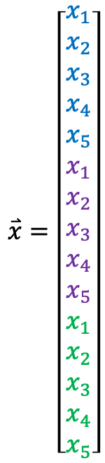





Solution 3: assume your input signal is periodic
1.
${[k}_{3}$, $k_{2}$, $k_{1}]$
$${{[x}_{1},x_{2},x_{3},x_{4},x_{5}, x}_{1},x_{2},x_{3},x_{4},x_{5},x_{1},x_{2},x_{3},x_{4},x_{5}]$$
2.
${[k}_{3}$, $k_{2}$, $k_{1}]$
$$⋮$$
$${{[x}_{1},x_{2},x_{3},x_{4},x_{5}, x}_{1},x_{2},x_{3},x_{4},x_{5},x_{1},x_{2},x_{3},x_{4},x_{5}]$$
$$\overset{⃑}{x}=\left[\begin{matrix}x_{1} \\ x_{2} \\ x_{3} \\ x_{4} \\ x_{5} \\ x_{1} \\ x_{2} \\ x_{3} \\ x_{4} \\ x_{5} \\ x_{1} \\ x_{2} \\ x_{3} \\ x_{4} \\ x_{5}\end{matrix}\right]$$
6.
${[k}_{3}$, $k_{2}$, $k_{1}]$
$${{[x}_{1},x_{2},x_{3},x_{4},x_{5}, x}_{1},x_{2},x_{3},x_{4},x_{5},x_{1},x_{2},x_{3},x_{4},x_{5}]$$
7.
${[k}_{3}$, $k_{2}$, $k_{1}]$
$${{[x}_{1},x_{2},x_{3},x_{4},x_{5}, x}_{1},x_{2},x_{3},x_{4},x_{5},x_{1},x_{2},x_{3},x_{4},x_{5}]$$
8.
${[k}_{3}$, $k_{2}$, $k_{1}]$
$${{[x}_{1},x_{2},x_{3},x_{4},x_{5}, x}_{1},x_{2},x_{3},x_{4},x_{5},x_{1},x_{2},x_{3},x_{4},x_{5}]$$
9.
${[k}_{3}$, $k_{2}$, $k_{1}]$
$${{[x}_{1},x_{2},x_{3},x_{4},x_{5}, x}_{1},x_{2},x_{3},x_{4},x_{5},x_{1},x_{2},x_{3},x_{4},x_{5}]$$
10.
${[k}_{3}$, $k_{2}$, $k_{1}]$
$${{[x}_{1},x_{2},x_{3},x_{4},x_{5}, x}_{1},x_{2},x_{3},x_{4},x_{5},x_{1},x_{2},x_{3},x_{4},x_{5}]$$
11.
${[k}_{3}$, $k_{2}$, $k_{1}]$
$${{[x}_{1},x_{2},x_{3},x_{4},x_{5}, x}_{1},x_{2},x_{3},x_{4},x_{5},x_{1},x_{2},x_{3},x_{4},x_{5}]$$
12.
${[k}_{3}$, $k_{2}$, $k_{1}]$
$$⋮$$
$${{[x}_{1},x_{2},x_{3},x_{4},x_{5}, x}_{1},x_{2},x_{3},x_{4},x_{5},x_{1},x_{2},x_{3},x_{4},x_{5}]$$

Slide 15
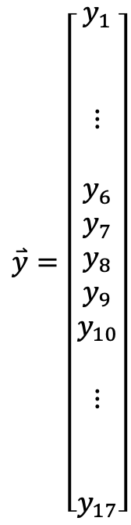
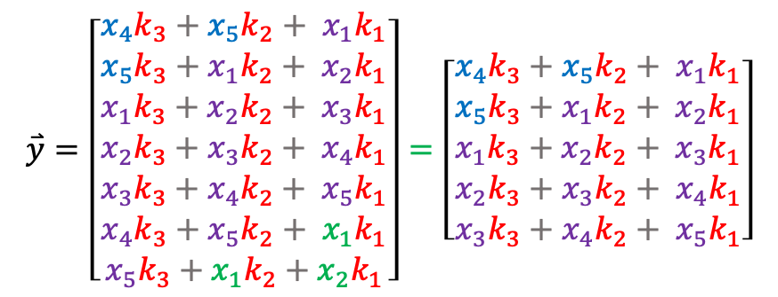
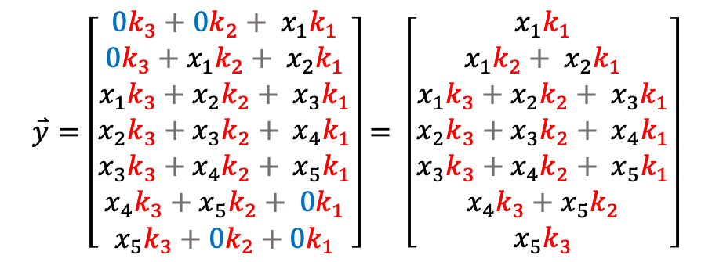
Periodic boundary handling, cont’d
Our input is n=5, and we want our output to be n=5
$$\overset{⃑}{x}=\left[\begin{matrix}x_{1} \\ x_{2} \\ x_{3} \\ x_{4} \\ x_{5} \\ x_{1} \\ x_{2} \\ x_{3} \\ x_{4} \\ x_{5} \\ x_{1} \\ x_{2} \\ x_{3} \\ x_{4} \\ x_{5}\end{matrix}\right]$$
$$\overset{⃑}{y}=\left[\begin{matrix}y_{1} \\ \\ \\ ⋮ \\ \\ y_{6} \\ y_{7} \\ y_{8} \\ y_{9} \\ y_{10} \\ \\ ⋮ \\ \\ \\ y_{17}\end{matrix}\right]$$
$$\overset{⃑}{y}=\left[\begin{matrix}{0k}_{3}+{0k}_{2}+ x_{1}k_{1} \\ {0k}_{3}+x_{1}k_{2}+ x_{2}k_{1} \\ x_{1}k_{3}+x_{2}k_{2}+ x_{3}k_{1} \\ x_{2}k_{3}+x_{3}k_{2}+ x_{4}k_{1} \\ x_{3}k_{3}+x_{4}k_{2}+ x_{5}k_{1} \\ x_{4}k_{3}+x_{5}k_{2}+ {0k}_{1} \\ {x_{5}k}_{3}+{0k}_{2}+0k_{1}\end{matrix}\right]= \left[\begin{matrix}x_{1}k_{1} \\ x_{1}k_{2}+ x_{2}k_{1} \\ x_{1}k_{3}+x_{2}k_{2}+ x_{3}k_{1} \\ x_{2}k_{3}+x_{3}k_{2}+ x_{4}k_{1} \\ x_{3}k_{3}+x_{4}k_{2}+ x_{5}k_{1} \\ x_{4}k_{3}+x_{5}k_{2} \\ x_{5}k_{3}\end{matrix}\right]$$
With zero-padding
$$\overset{⃑}{y}=\left[\begin{matrix}{x_{4}k}_{3}+{x_{5}k}_{2}+ x_{1}k_{1} \\ {x_{5}k}_{3}+x_{1}k_{2}+ x_{2}k_{1} \\ x_{1}k_{3}+x_{2}k_{2}+ x_{3}k_{1} \\ x_{2}k_{3}+x_{3}k_{2}+ x_{4}k_{1} \\ x_{3}k_{3}+x_{4}k_{2}+ x_{5}k_{1} \\ x_{4}k_{3}+x_{5}k_{2}+ {x_{1}k}_{1} \\ {x_{5}k}_{3}+{x_{1}k}_{2}+x_{2}k_{1}\end{matrix}\right]=\left[\begin{matrix}{x_{4}k}_{3}+{x_{5}k}_{2}+ x_{1}k_{1} \\ {x_{5}k}_{3}+x_{1}k_{2}+ x_{2}k_{1} \\ x_{1}k_{3}+x_{2}k_{2}+ x_{3}k_{1} \\ x_{2}k_{3}+x_{3}k_{2}+ x_{4}k_{1} \\ x_{3}k_{3}+x_{4}k_{2}+ x_{5}k_{1}\end{matrix}\right]$$
With periodic boundary padding

Slide 16
Exercise 1.4: Testing LSI systems
Is System 1 linear?
Yes!
2) Is it shift in variant?
Yes!
3) How does it handle boundaries?
Let’s see (white board)!

Slide 17
Solution:
System 1 is linear, shift invariant, and has periodic boundary handling
Is System 1 linear?
Yes.
2) Is it shift in variant?
Yes.
3) How does it handle boundaries?
Periodically.

Slide 18
Summary: LSI Systems pt. 1
Saying a system is LSI is a stronger statement than just saying it is linear
Measure one input/output pair (the impulse response), and you are done
The action of an LSI system on a signal is equivalent to the convolution operation
Convolution can be written as matrix multiplication (remember to flip the kernel)
Convolution (and thus LSI systems too), must ”deal with” signal boundaries
E.g. zero-padding, periodic/circular boundaries

Slide 19
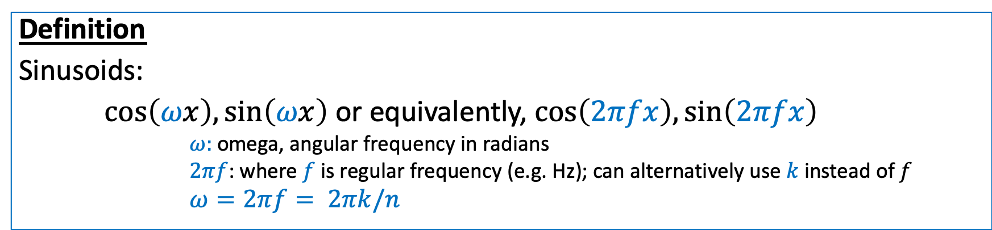
LSI systems part 2: Sines and cosines
Definition
Sinusoids:
$\cos\left(ωx\right),\sin\left(ωx\right)$ or equivalently, $\cos\left(2πfx\right),\sin\left(2πfx\right)$
$ω:$ omega, angular frequency in radians
$2πf$: where $f$ is regular frequency (e.g. Hz); can alternatively use $k$ instead of $f$
$ω=2πf= 2πk/n$

Slide 20
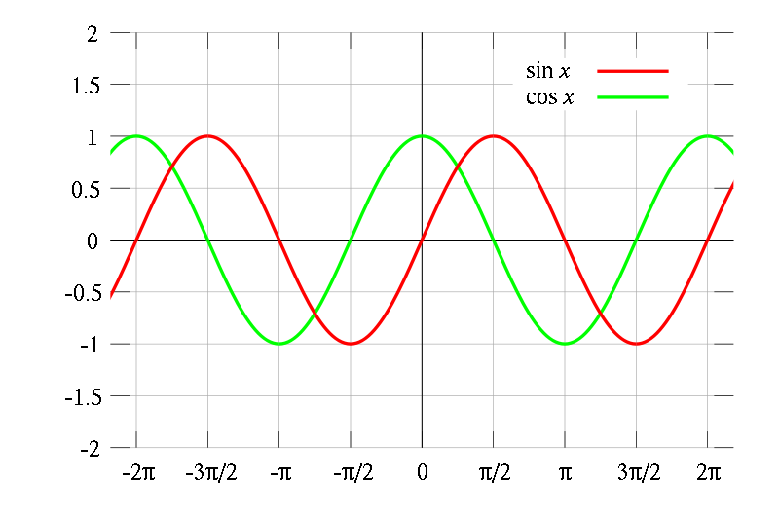
Recall sines and cosines
Source: wiki

Slide 21
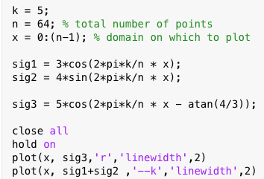
Exercise: Sinusoids are sinusoids
Plot 2 sinusoids:
1) What is the frequency?
2) What is the period?
3 )What is the phase shift of sig3?
4 ) How does sig3 relate to sig1+sig2?

Slide 22
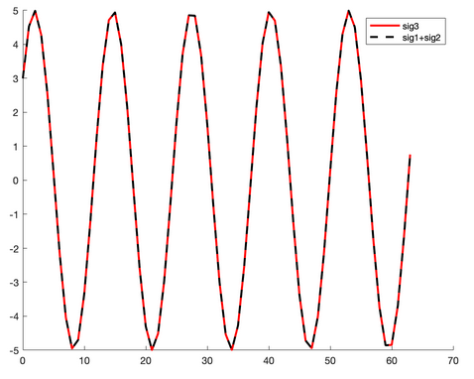
Solution:
1) What is the frequency?
They each have a frequency k/n = 5/64
2) What is the period?
Period is 1/f = 64/5, i.e. it takes 64/5 points until the signal repeats
3 ) What is the phase shift of sig3?
Sig3’s phase shift is atan(4/3) which is 0.9273 rads
4 ) How does sig3 relate to sig1+sig2?
sig3=sig1+sig2
$5\cos\left(2π\frac{k}{n} x−0.9273\right)=3\cos\left(2π\frac{k}{n} x\right)+4sin⁡(2π\frac{k}{n} x$)
Any phase-shifted sinusoid can instead be described as a combo of a cos() plus a sin() of the same frequency without a phase shift

Slide 23
Fourier series, informally
ANY function can be represented as:
a sum of sinusoids of different frequencies

Slide 24
The Fourier transform -- intuition
Project a signal onto orthogonal basis (i.e. a rotation of the space)
Each axis represents a different (cos+sin) pair of a different frequency
Notes:
Draw on board

Slide 25
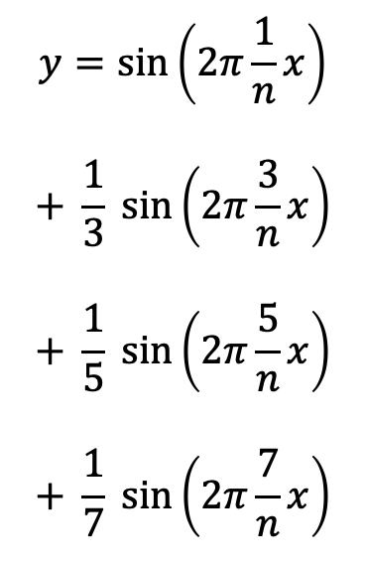
Exercise 3.1: Sinusoids as building blocks
n=1000;
x = (0:n-1)';
hold on
y = sin(2*pi*1/n * x);
plot(y)
y = y+ 1/3*sin(2*pi*3/n * x);
plot(y)
y= y+ 1/5*sin(2*pi*5/n * x);
plot(y)
y= y+ 1/7*sin(2*pi*7/n * x);
plot(y)
$$y=\sin\left(2π\frac{1}{n}x\right)$$
$$+ \frac{1}{3} sin\left(2π\frac{3}{n}x\right)$$
$$+ \frac{1}{5} sin\left(2π\frac{5}{n}x\right)$$
$$+ \frac{1}{7} sin\left(2π\frac{7}{n}x\right)$$
Can you see the pattern?

Slide 26
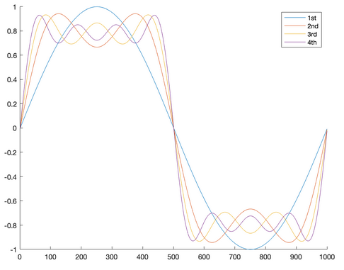
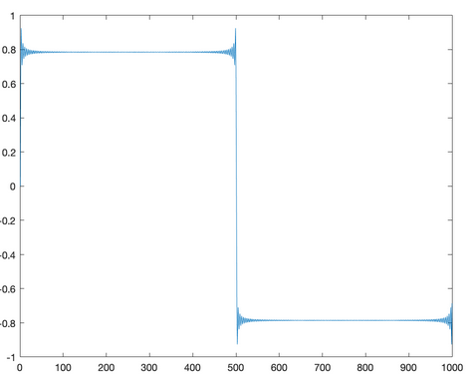
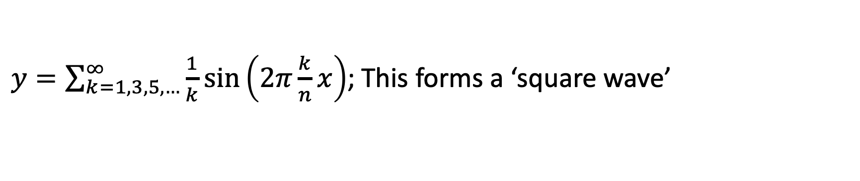
Solution 3.1: Sinusoids as building blocks
After adding the 125th sine wave…
$y=\sum_{k=1,3,5,…}^{∞}{\frac{1}{k}}sin\left(2π\frac{k}{n}x\right)$; This forms a ‘square wave’
You can synthesize (almost) any function/signal from a bunch of sinusoids of different frequencies.

Slide 27
Summary: Sinusoids
Any signal can be synthesized from many cosines and sines at different frequencies
Conversely…
Any signal can be decomposed into many cosines and sines at different frequencies
↑ This is what the Fourier transform does.

Slide 28
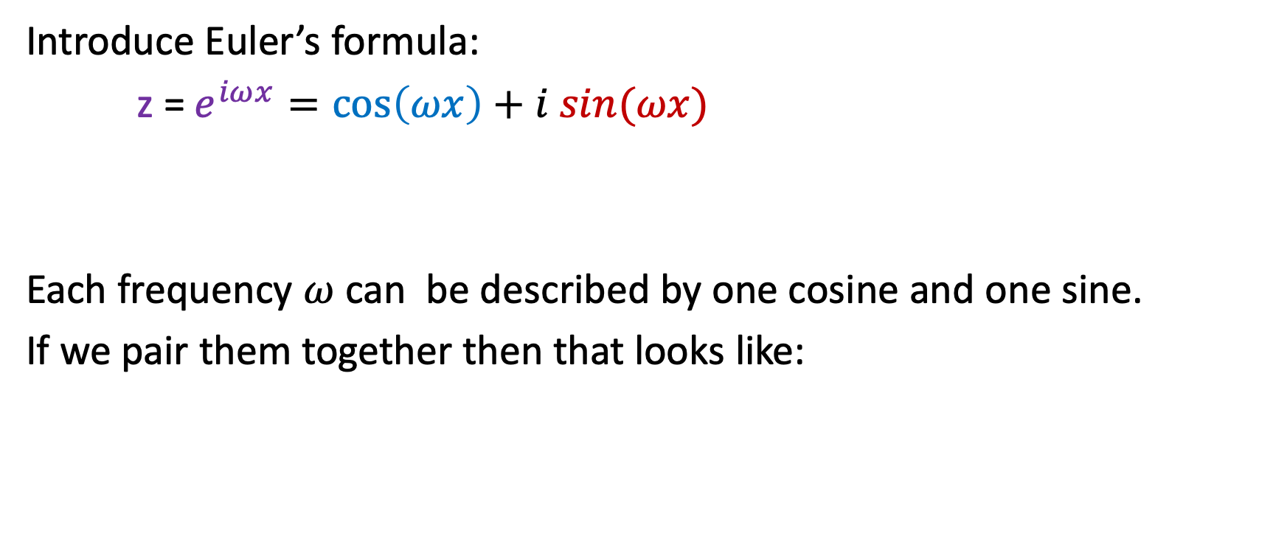
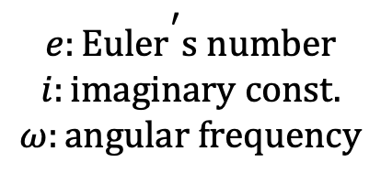
Imaginary numbers and sinusoids are intimately related
Introduce Euler’s formula:
z =$e^{iωx}=\cos\left(ωx\right)+i sin(ωx)$
Each frequency $ω$ can be described by one cosine and one sine.
If we pair them together then that looks like:
$$e:\text{Eule}{\text{r}}^{\text{′}}\text{s} \text{number}$$
$$i:\text{imaginary} \text{const}\text{.}$$
$$ω:\text{angular} \text{frequency}$$

Slide 29
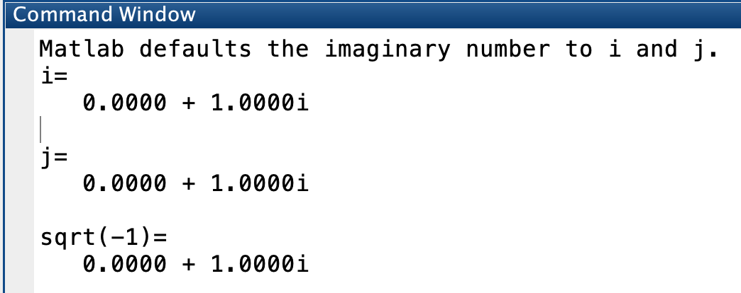
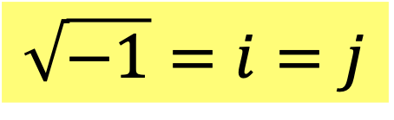
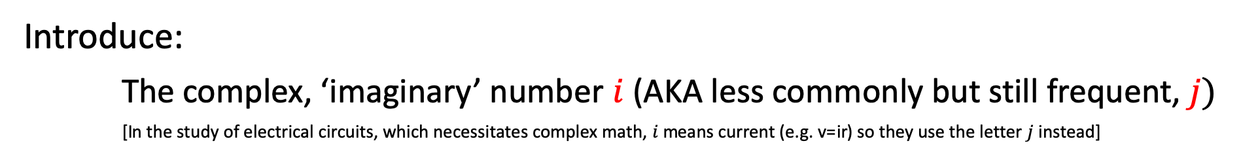
‘Complex math’ does not have to mean ‘difficult math’!
Introduce:
The complex, ‘imaginary’ number $i$ (AKA less commonly but still frequent, $j)$
[In the study of electrical circuits, which necessitates complex math, $i$ means current (e.g. v=ir) so they use the letter $j$ instead]
$$\sqrt{−1}=i=j$$
This is one reason why you shouldn’t name your for-loop variables i or j, and should use ii or jj instead

Slide 30
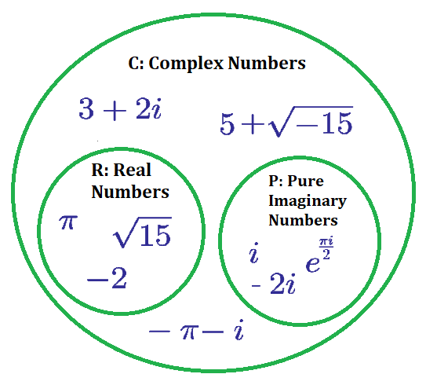
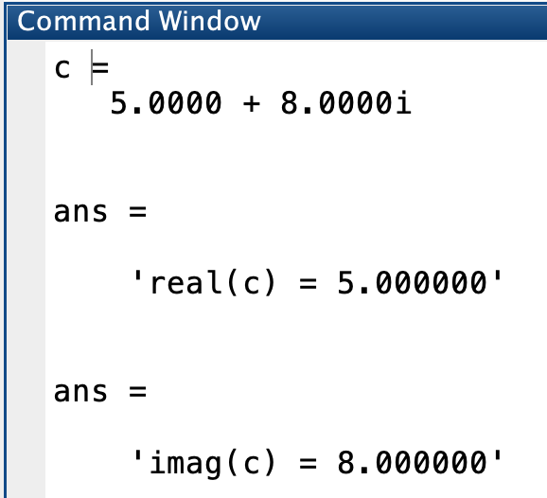
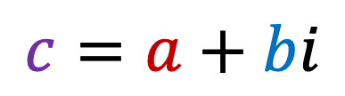


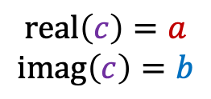
The rules of complex algebra
In MATLAB:
$$c=a+bi$$
Real part
Imag. part
$c$ is just one number comprising 2 parts
$$\text{real}\left(c\right)=a$$
$$\text{imag}\left(c\right)=b$$
How $i$ think of complex numbers:
A notational convenience in order to pack 2 numbers into 1

Slide 31
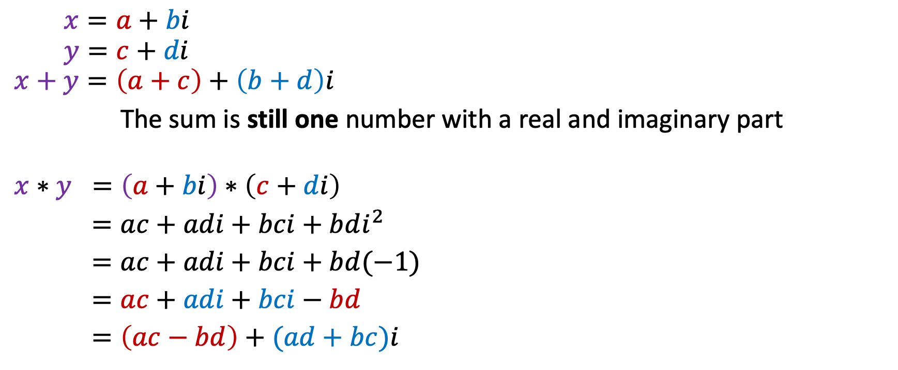

The rules of complex algebra
$$x=a+bi$$
$$y=c+di$$
$$x+y=\left(a+c\right)+\left(b+d\right)i$$
The sum is still one number with a real and imaginary part
$$x∗y =\left(a+bi\right)∗\left(c+di\right)$$
$=ac+adi+bci+bdi^{2}$
$=ac+adi+bci+bd(−1)$
$=ac+adi+bci−bd$
$=\left(ac−bd\right)+(ad+bc)i$
$i=\sqrt{−1}$, so $i^{2}={(\sqrt{−1})}^{2}=−1$
Real part
Imag. part
The product is again one number with a real and imaginary part

Slide 32
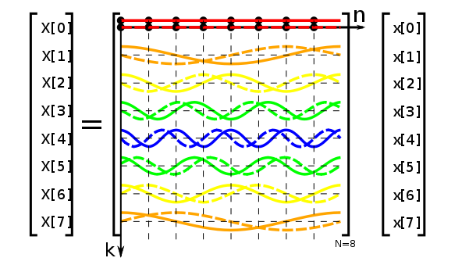

The (discrete) Fourier transform (DFT)
Lowercase letters denote original signal
Capital letters usually denote Fourier transformed signal
$X=F\left(x\right)=Dx$; where D is the DFT matrix

Slide 33
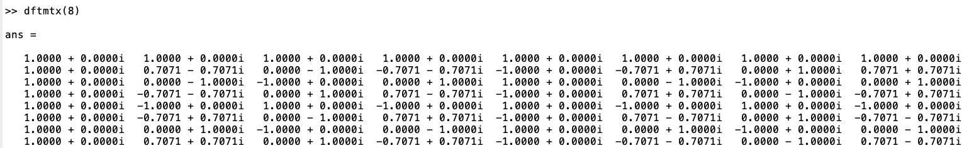
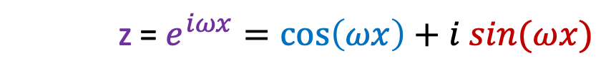
The DFT is an orthogonal matrix!
z =$e^{iωx}=\cos\left(ωx\right)+i sin(ωx)$

Slide 34
Exercise 3.2: Decomposing a signal using DFT
Using the same signal that we just created in 3.1.
Compute its DFT and plot its amplitude spectrum

Slide 35
The inverse (discrete) Fourier transform (IDFT)
If the DFT is an orthogonal matrix, what is the inverse DFT?
The transposed complex conjugate of the DFT matrix!

Slide 36

Power and amplitude spectrum
Amplitude spectrum: $|F\left(x\right)|$
Power spectrum: ${|F\left(x\right)|}^{2}$

Slide 37
Signal vs. Fourier domain
Signal and Fourier representations are two sides of the same coin

Slide 38
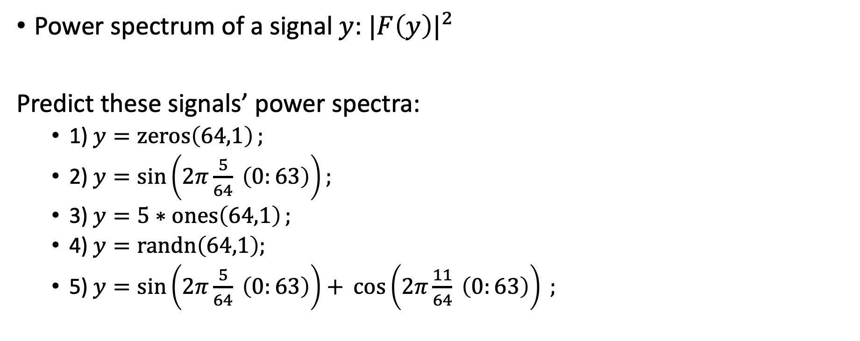
Exercise:
Power spectrum of a signal $y$: ${|F\left(y\right)|}^{2}$
Predict these signals’ power spectra:
1) $y=\operatorname{zeros}\left(64,1\right);$
2) $y=\sin\left(2π\frac{5}{64} \left(0:63\right)\right);$
3) $y=5∗ones\left(64,1\right);$
4) $y=\operatorname{randn}\left(64,1\right);$
5) $y=\sin\left(2π\frac{5}{64} \left(0:63\right)\right)+ \cos\left(2π\frac{11}{64} \left(0:63\right)\right) ;$

Slide 39
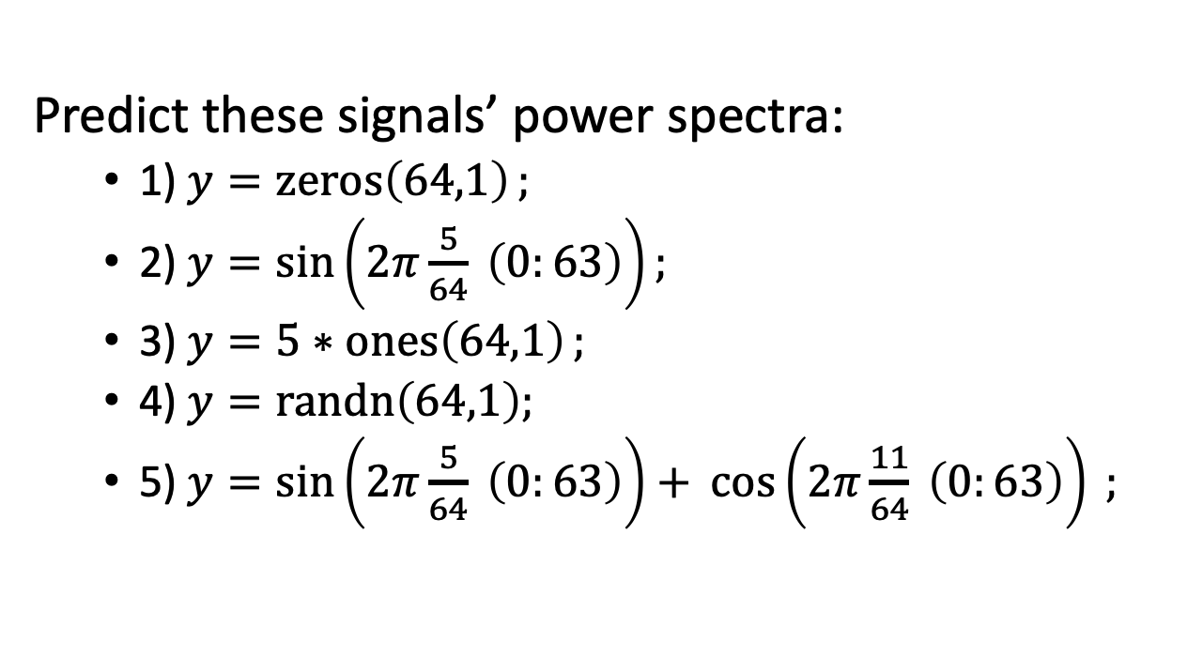
Solution:
Predict these signals’ power spectra:
1) $y=\operatorname{zeros}\left(64,1\right);$
2) $y=\sin\left(2π\frac{5}{64} \left(0:63\right)\right);$
3) $y=5∗ones\left(64,1\right);$
4) $y=\operatorname{randn}\left(64,1\right);$
5) $y=\sin\left(2π\frac{5}{64} \left(0:63\right)\right)+ \cos\left(2π\frac{11}{64} \left(0:63\right)\right) ;$

Slide 40
Summary 2: Fourier transforms
How does this relate to Linear shift invariant systems?
Sinusoids are ‘eigenfunctions’ of LSI systems!
You put in an input of cos+sin of a given frequency, and the output is a cos+sin of that same frequency but each with possibly different amplitudes.

Slide 41
Recommended short videos/articles:
Convolution:
Convolution as matrix multiplication
Fourier stuff:
Sines and cosines from vectors (Khan Academy, 3mins)
Complex numbers and vectors (Khan Academy, 8mins)
Nyquist sampling:
Nyquist frequency
Aliasing

